Slide 1
Interpreting images

Slide 2
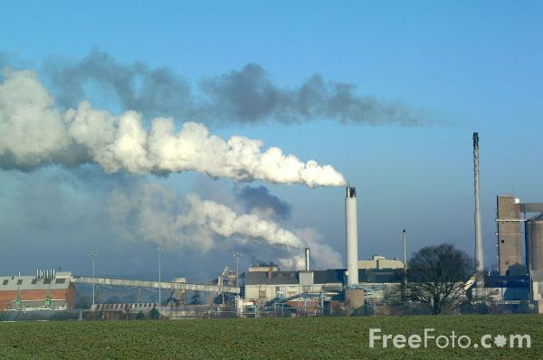

Slide 3
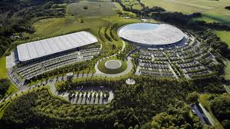

Slide 4
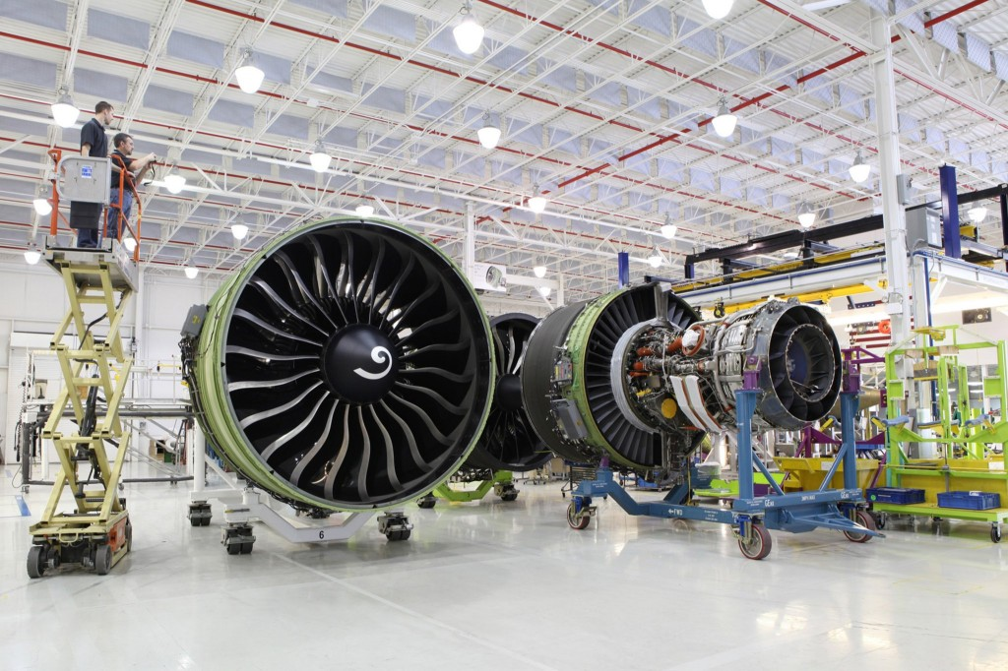

Slide 5
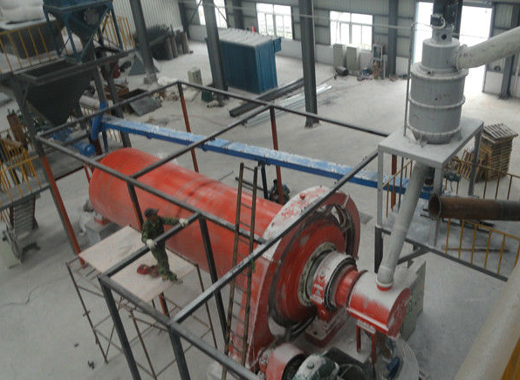

Slide 7
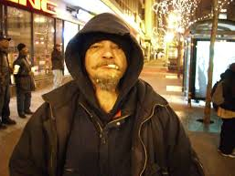

Slide 8
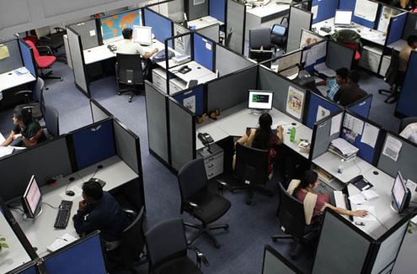

Slide 9
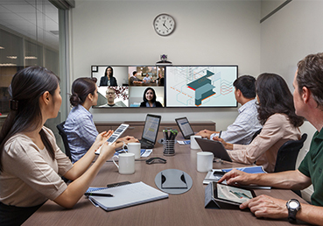

Slide 10
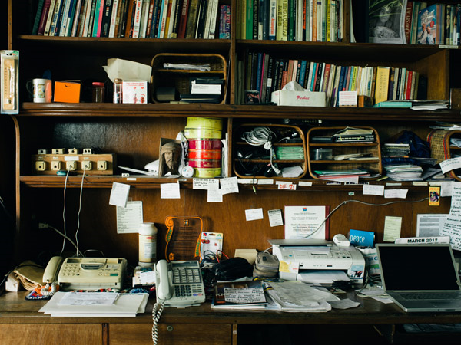

Slide 11
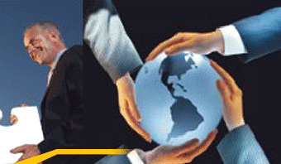

Slide 13
The grammar of visual design
Kress and van Leeuwen
2006

Slide 14
Analytical images
The represented image, Carrier, has Attributes
The man looks dirty. The woman is wearing a lab coat.
She looks competent and clean.

Slide 15
Composition
Given | Element on the left in a polarized composition or left polarized element in a centred composition. Not identical or near-identical to the corresponding right element. This is what we know.
New | Element on the right in a polarized composition or the right polarized element in a centred composition. Not identical or near-identical to the corresponding left element. This is what we focus on.

Slide 16
Composition
Given: what we know, the starting point: the staff
New: what is new, what to pay attention to: technology

Slide 17
Composition
Given: our personnel are part of a larger group
New: we are present and work all over the world

Slide 18
Composition
Ideal | Element on top in a polarized composition or the top polarized element in a centred composition. Not identical or near-identical to the corresponding bottom element. This is what we desire.
Real | Element on the bottom in a polarized composition or the bottom polarized element in a centred composition. Not identical or near-identical to the corresponding top element. This is what we can have or can be.

Slide 19
Composition
Ideal: this is what we strive for
= we have good ideas; we are innovative
Real: this is what we can have/be = we work together

Slide 20
Composition
Ideal: we would like to have fun + Standard
= Standard oil will help us have fun
Real: this could be us in the car

Slide 21
Interpersonal perspective
Frontal angle | Represents involvement; part of our world
Oblique angle | Represents detachment; not part of our world
High angle | Represents power, viewer looks down on object (attitude towards represented participant) viewer power
Horizontal angle | Represents equality
Low angle | Represents lack of power, viewer looks up at object represented participant power

Slide 22
Oblique high angle: we are not part of the world of this factory

Slide 23
Given: low angle: we look up to this man; he deserves our confidence New: high, close, frontal angle: we are in the position of people holding the globe; we are all in control

Slide 24
Horizontal angle: we are on an equal footing with the people in the room

Slide 25
Size of frame and social distance
Intimate/personal Close shot / close distance | Head & shoulders of represented participant Object could be used by viewer Building shown as if viewer about to enter it
Social Medium long shot / middle distance | Full figure Object shown in full with little space around it Building shown as objective destination of viewer
Impersonal Long shot / long distance | Figure occupies half of frame or less Object for contemplation but out of reach Building shown at a distance & out of reach, e.g. behind gates

Slide 26
Impersonal: factory far away

Slide 27
Close social distance: we could be in the room with the people

Slide 28
Composition
Given: Caltex has advantages
Sun rising
New: Caltex station & sign

Slide 29
Representation
Caltex sign = Attributes (qualities of product & company
Sun rising = a new day

Slide 30
Interpersonal
Low oblique angle = we could be driving into the station

